Slide 1
ENERO 31, 2023
FUNDAMENTOS de
Big data

Slide 2
Qué es BigData
Nuevo enfoque para entender los datos, dar valor y tomar decisiones, a partir de la descripción de datos (estructurados, no estructurados o semi estructurados) analizados desde un punto de vista no relacional (costo, tiempo, recursos), utilizando herramientas de supercómputo nativo o en la nube.

Slide 3
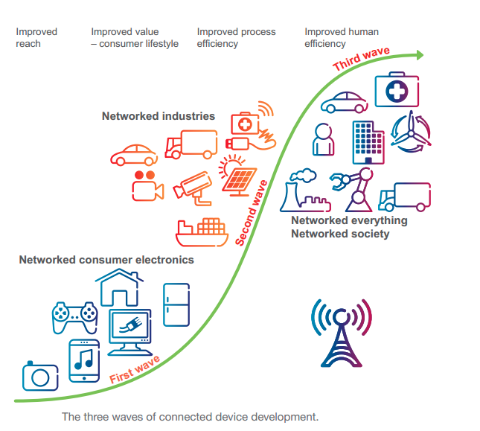
La relación del Big Data con otras tecnologías
Gran masa
Diversidad
Almacenamiento
Seguridad
Tomar decisiones y responder

Slide 4
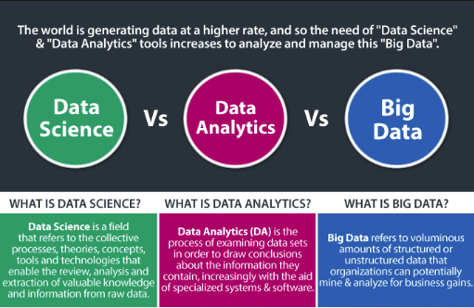
Qué es BigData

Slide 5
Qué es BigData
Big Data
Data Science
Machine Learning
NPL
Data Analytics
Architecture
Infrastructure
Processing
Storage
Segmentation and selection

Slide 6
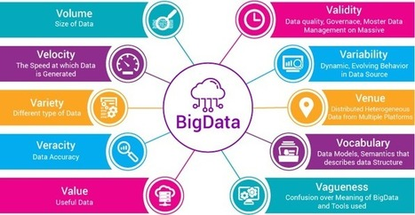
Qué es BigData, 10 V’s

Slide 7


Qué es Big Data

Slide 8
Qué es necesario
Infraestructura
Fuente(s) de datos
Modelo matemático

Slide 9
Big Data, generalidades
Los motores de BD tradicionales no pueden tratar altas cantidades de datos, ni reaccionar inmediatamente a ellos. Almacena datos no relacionales y relacionales.
Esquemas de consulta:
Key-value
Columnal
Documental
Gráfos

Slide 10
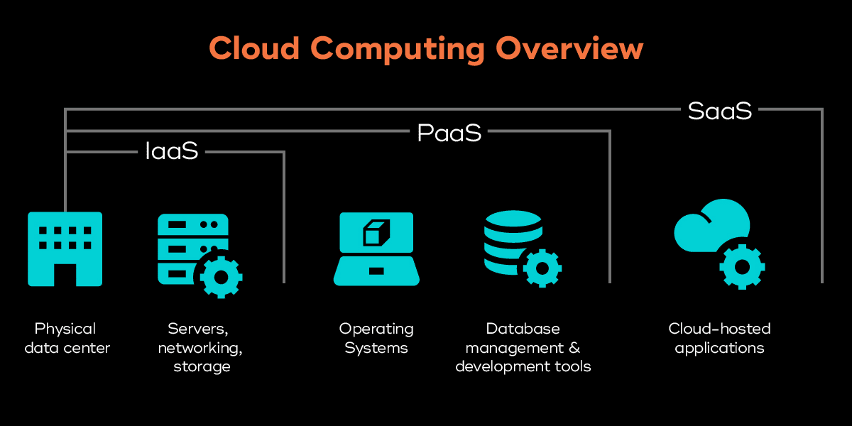
IaaS, Infrastructure as a Service
PaaS, Platform as a Service
SaaS, Software as a Service

Slide 11
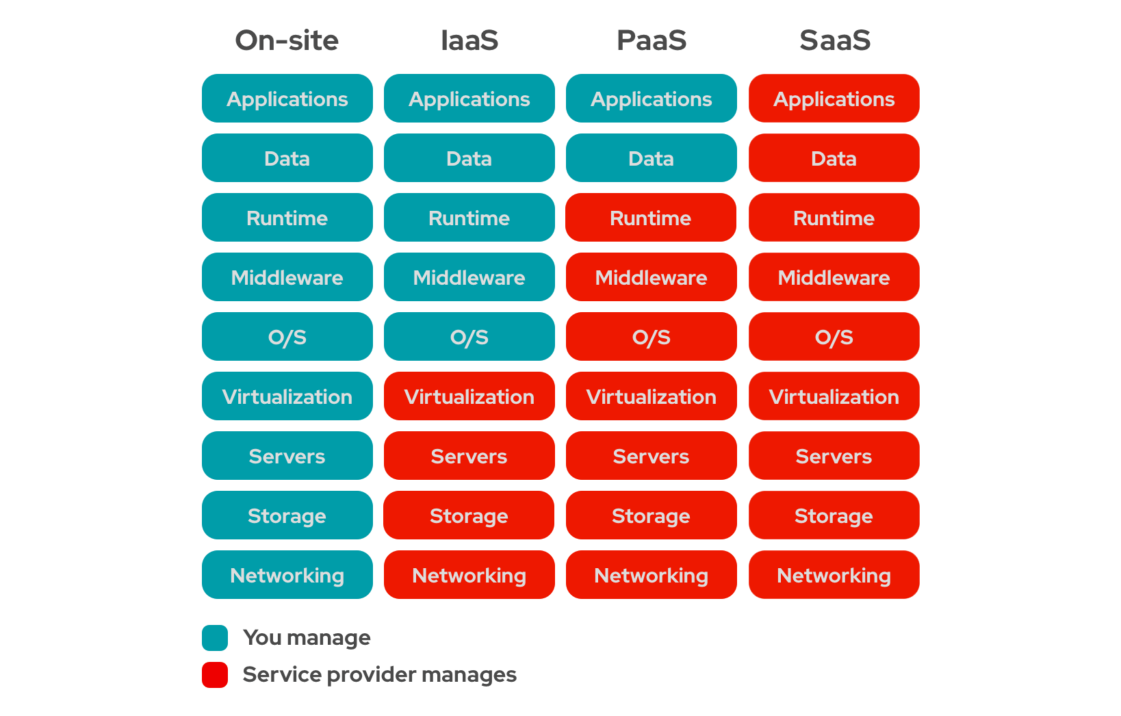
Escenarios de cómputo en la nube

Slide 12




Tecnologías líderes Big Data engine

Slide 13
Qué se puede hacer con BigData
La nube consumía software, la nube ahora consume datos e integrando software desde donde se puede obtener información inteligente:
Análisis retrospectivo
Análisis en tiempo real
Análisis predictivo
App Inteligentes SaaS
Datos
Supervisados
No supervisados
IA
Machine Learning
Redes Neuronales

Slide 14
Queue adicional y backup
Sharding

Slide 15
Algo de historia
Big Data fue precedido por Google (mapreduce), Amazon (Dynamo) y Software Open Source (Hadoop, MongoDB, Cassandra, RabbitMQ, etc)
RDBMS tienen funciones específicas donde las relaciones entre los datos toman valor único

Slide 16
Propiedades deseadas de un BD
Robustes y tolerancia a fallas
Baja latencia y actualizaciones
Escalabilidad
Generalización
Extensabilidad
Queries ad-hoc
Mantenimiento mínimo
Debugabilidad
Problemas de Arq. Incremental (nuevas funciones)

Slide 17
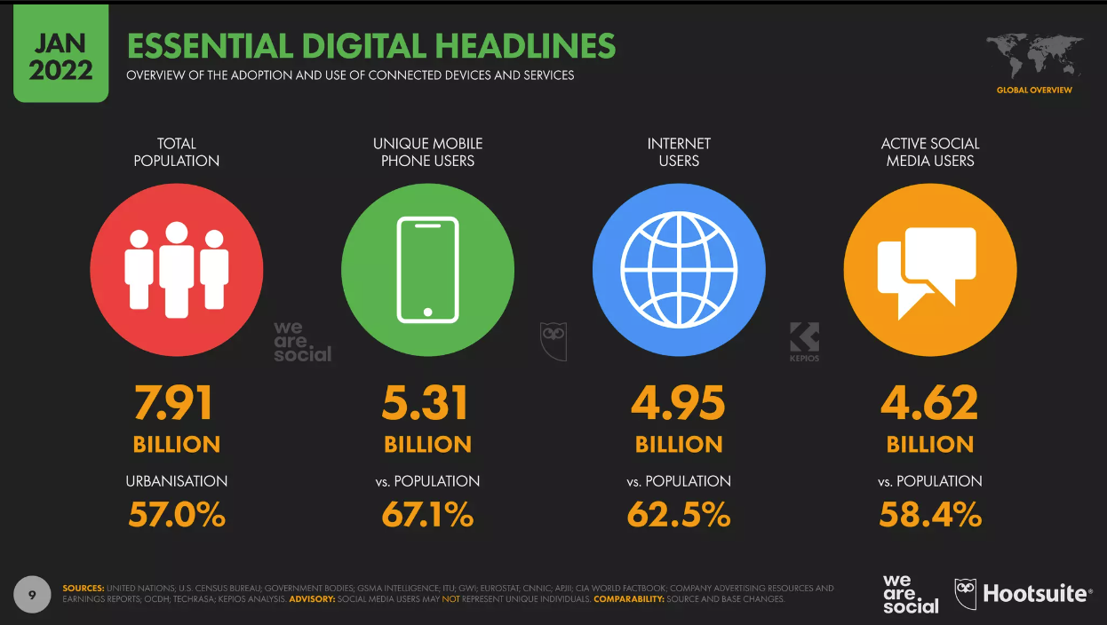

Slide 18
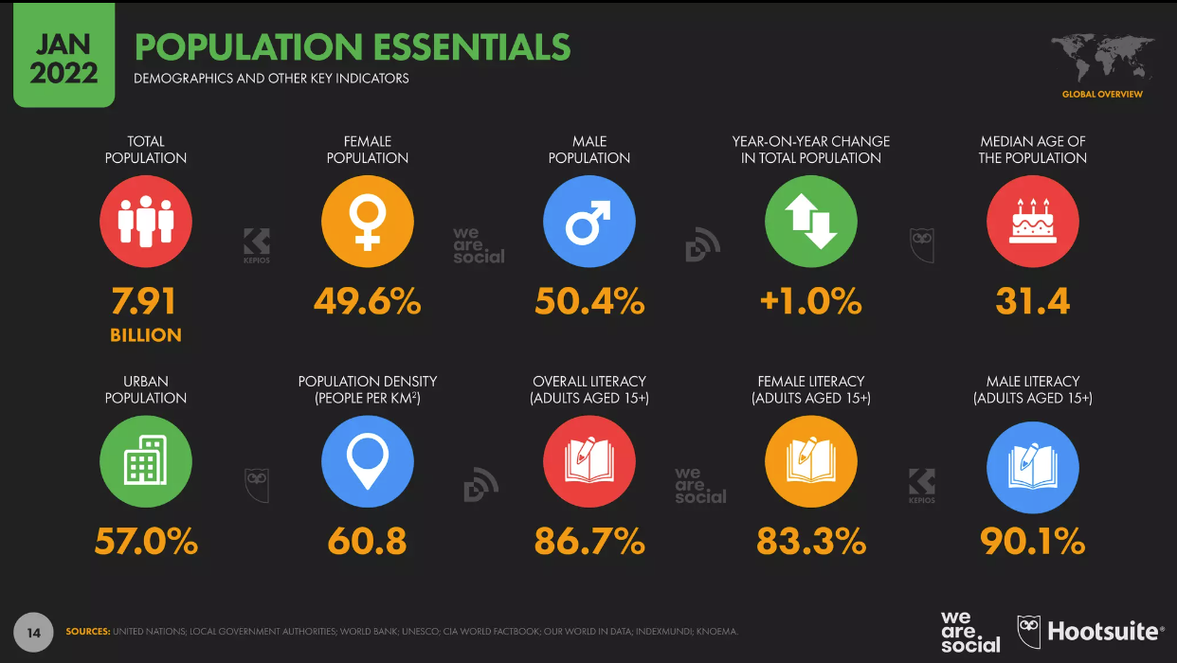

Slide 19
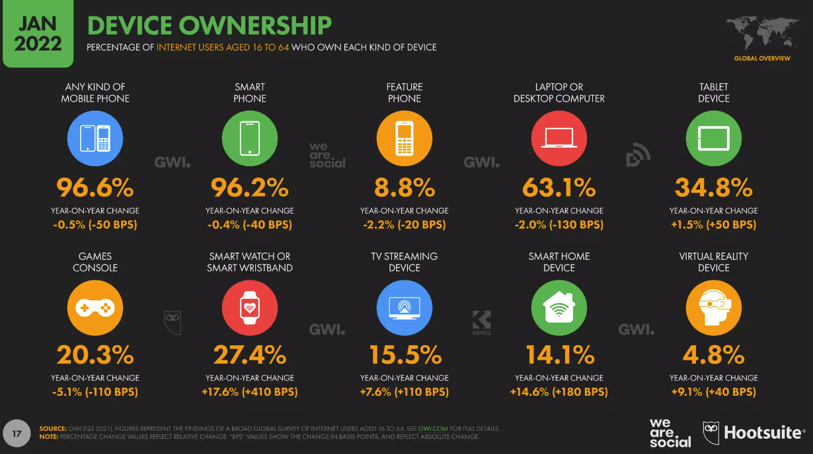

Slide 20
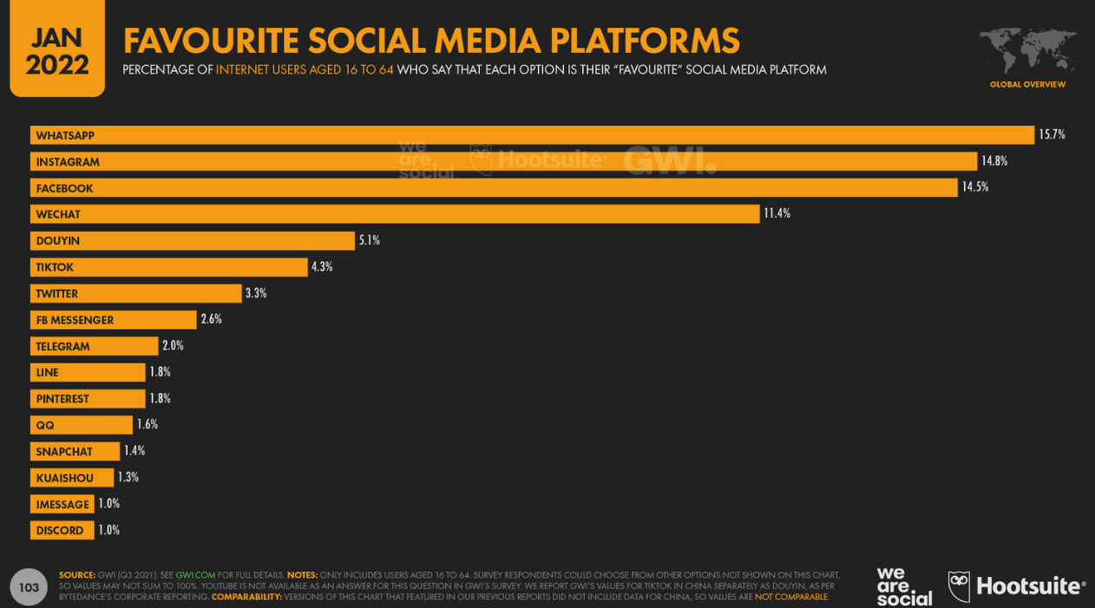

Slide 21
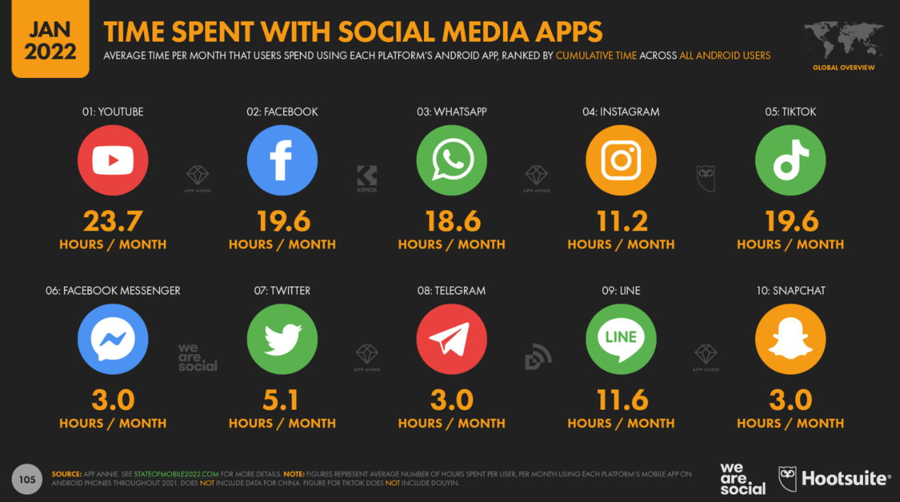

Slide 22
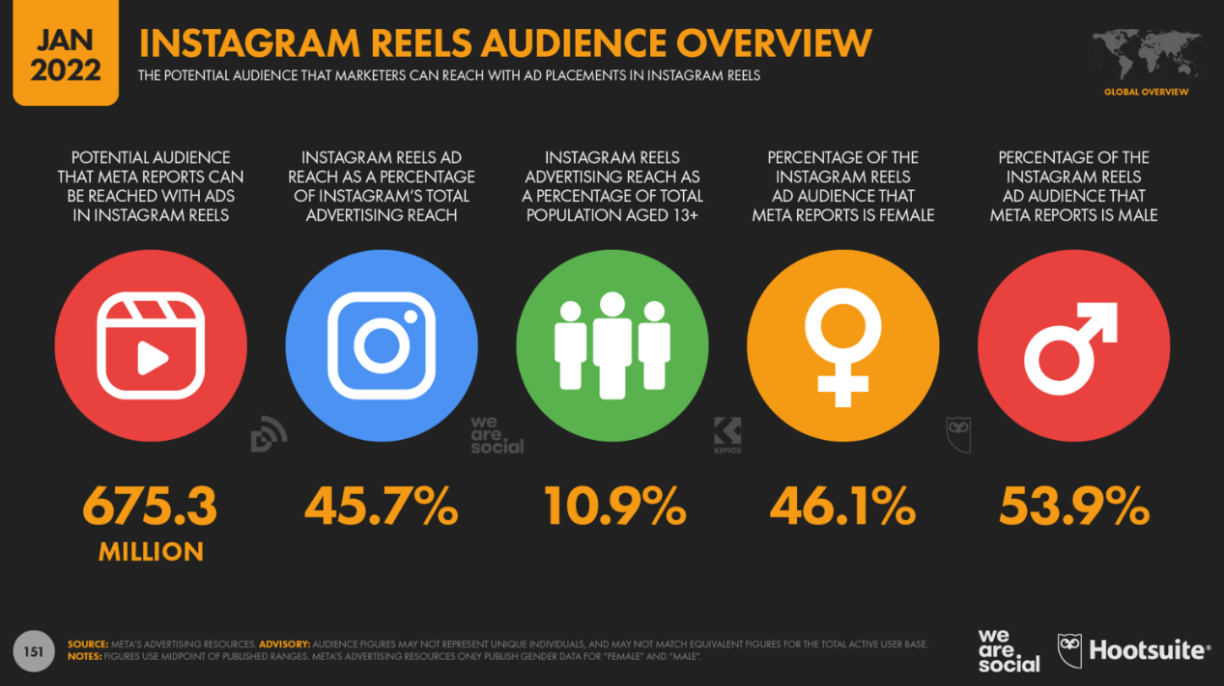

Slide 23

Necesidades Globales de datos:
Crecimiento de logs exponencial
Crecimiento de demanda
Crecimiento de popularidad
Mayor inteligencia

Slide 24
¿Existe una correlación entre el nivel de vida de un país medido por el ingreso econoómico de su población, edad y el acceso a internet?dlakjdslkajshd
https://global-internet-map-2022.telegeography.com/
https://datareportal.com/reports/digital-2022-global-overview-report

Slide 25
Data sources types in Big Data
Structured
None structured
Semi-structured

Slide 26
Structured Data
Big mass
Diversity
Storage
Security
Decision Support Systems and Answers Recovery

Slide 27
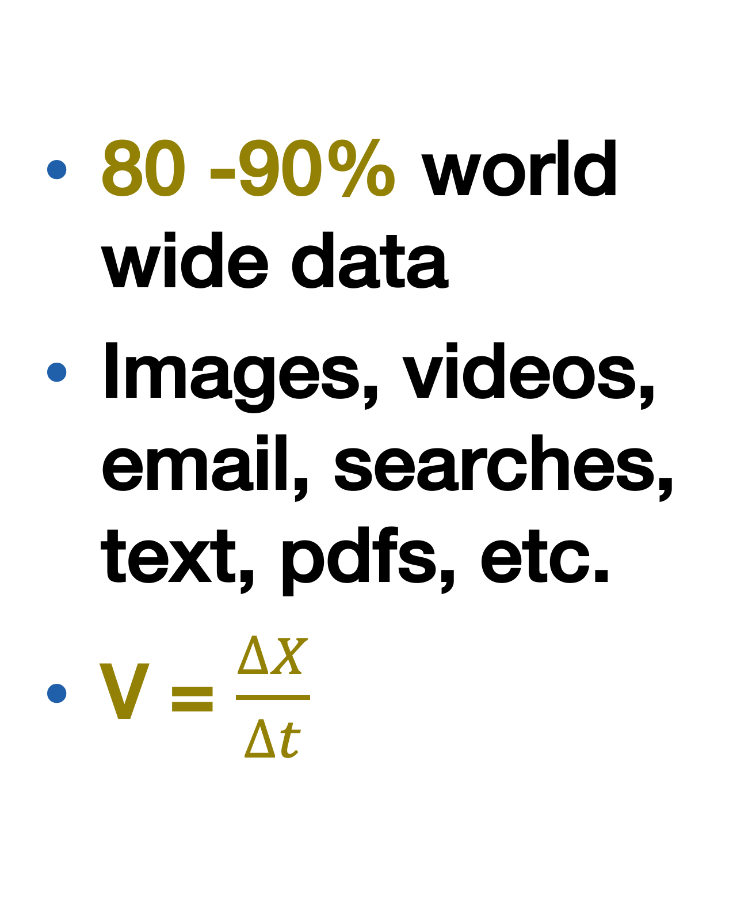
None Structured Data, Organizations
80 -90% world wide data
Images, videos, email, searches, text, pdfs, etc.
V = $\frac{∆X}{∆t}$

Slide 28
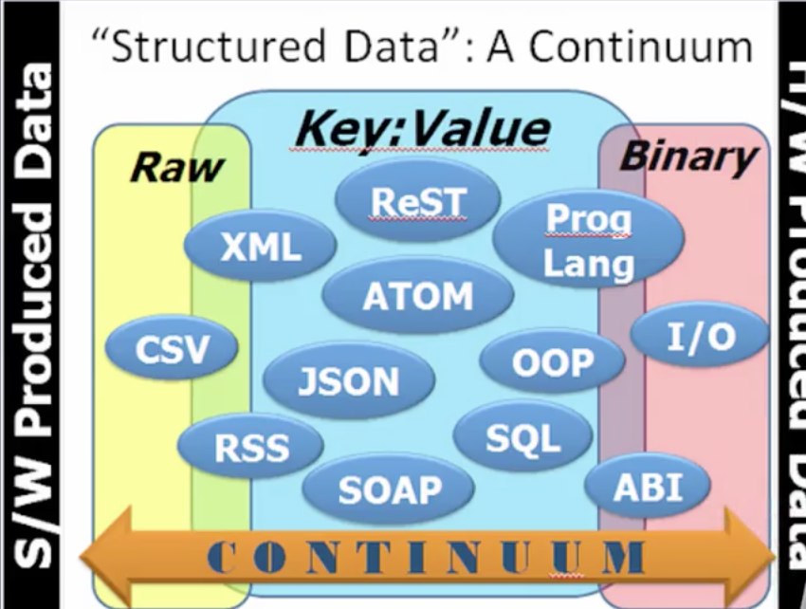
Data schemas, samples

Slide 29
Structured Data, Organizations
Past stored in SILOS
- Unconnected stored islands
- Hindered stored and connect silos for pattern recognition
- Outdated and unsynchronized
RDMS (Highly structured data) – SILOS → Value

Slide 30
Structured Data, Organizations
Using pattern recognition a organizations can use it for:
1.- Detect correlated products
2.- Estimated demand
3.- Dapture fraudulent actions
Commerce+Open Data+Analytics→Better predictions (Business Intelligence)

Slide 31
Semi- Structured Data
16 PB data per year
1 mile per driver route optimized, savings 50 mdd
250 millions clients, 10000 stores
2.5 PB per hour
New products, customize recommendations, predictive support

Slide 32
None-Structured Data, work path
Data acquisition
Storage
Retrieval
Cleaning
Processing

Slide 33
For all data workload
ETL data
(Extract, Transform and Load)
To integrate different sources and loaded it into:
Data Warehouse-Data Lake-Data Mart

Slide 34
4 key properties of a data transaction
Atomicity
All changes to data are performed as if they are a single operation
Consistency
Data is in a consistent state when a transaction starts and when it ends.
Isolation
The intermediate state of a transaction is invisible to other transactions. As a result, transactions that run concurrently appear to be serialized.
Durability
After a transaction successfully completes, changes to data persist and are not undone, even in the event of a system failure.

Slide 35

None Structured Data, NoSQL
Graph Data Base.– used to find connections between data sets (Neo4j)
Key Value Pairs.- access and process data with key value pairs (Cassandra)
→Layers for Value Big Data
→Retrival and Storage
→Pre-processing
→Analysis
12 TB/day representative data to sentiment analysis for a product or service (crisis mappers)

Slide 36
None Structured Data, NoSQL
Flow decision making
Correlation
Estimation
Prediction
Action

Slide 37
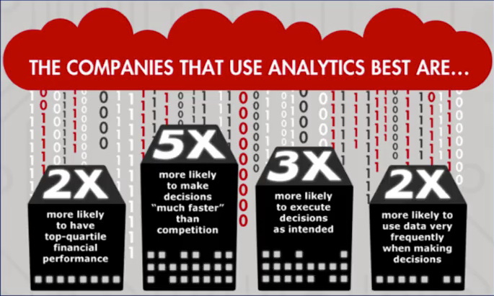
Strategical Big Data growth, new economical system approach

Slide 38
Data integration Process
Discovering
Accessing
Monitoring
Modeling
Transforming
More integration
More Value (Reduce data complexity)
Data collaboration

Slide 39
Team 1
Team 2
Link
Team 3
Team 4
Link
Team 5
Link
Link
Link
Activity 2:
Read the appropiate article according the assignated team.
Answer the questiones asignated to the article.
Every team must prepare and present a 5 minute resume

Slide 40
Questions Team 1:
Does the Reels are changing the consumer experiences and it reflect a new data Vs value?
Wich one’s and how?
What trends (3) do you identify after Covid-19 over data user production?
Are those data commonly Structured, NoStructured or SemiStructured? Explain, why?
Questions Team 2:
What are the relations between Data Analytics and Business Intelligence (3)?
What are the relations between Data Science and Business Intelligence (3)?
How do you explain this for a new user or Company who wants to be involved in BI?
How could they start with it?

Slide 41
Questions Team 3:
For the 12 data keypoint, how many of them are affeted by AI?
In conclusion, the D&A should be focused on people or metaverse? Explain, why?
How do you resume this article in one paragraph?
Does geopolitics are changing data production and consumtion?
Questions Team 4:
How do you represent graphically the relation between Data Science-ML-AI?
How do you explain the role of Big Data in Data Science, ML and AI?
Describe three agrees, and three disagrees about the article’s content
According the study case: “Self-driving car”. Do you agree with the ML, AI and Data Science descriptions? Explain, What is the Big Data role in this case according 10 V’s?

Slide 42
Questions Team 5:
Does Data Scientist and Data Engineer would do the same job? Explain, why?
Define five key skills that make difference between Data Scient and Data Engineer
Does DASCA is leading changing the employment bases for Data Scientist and Data Engineers?
How has been involved the Big Data in this new industrial revolution called 4.0?

